Slide 1

History of
The Partnership for Excellence
As of 7/6/2023

Slide 2
1997 -1998
Formative Years
Governor George Voinovich’s Comments

Slide 3

Chartered as the
Ohio Award for Excellence on October 6, 1998

Slide 4

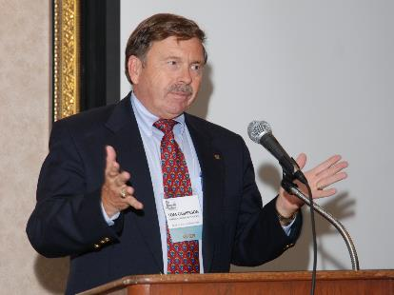
Tom Casperson
First Executive Director
Loaned Executive from NCR

Slide 5

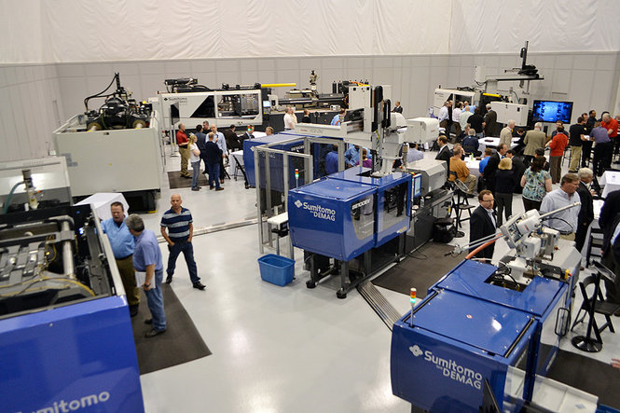
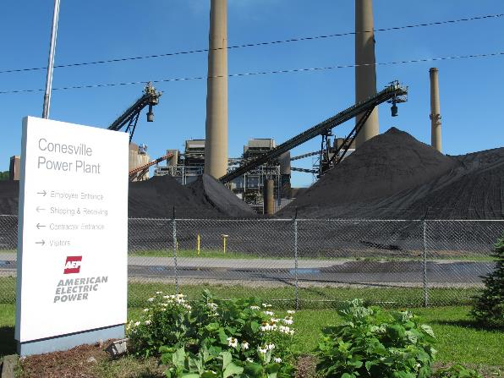
First Award Cycles
First award cycle – 2000
30 Applicants
  20 Tier 1
  6 Tier 2
  4 Tier 3
  No Governor’s Award
First Governor’s Award Recipients - 2001
Van Dorn Demag Corporation, Strongsville, OH
American Electric Power, Conesville, OH

Slide 6

Ohio Partnership for Excellence
Name legally changed on 12/28/2004

Slide 7


The Partnership for Excellence
In 2011, Indiana & West Virginia joined Ohio
Name legally changed 7/31/2012

Slide 8
Illinois Performance Excellence (ILPEx) joins
The Partnership for Excellence (TPE)
TPE expands into Illinois and becomes a 4-state regional program on 1/1/2023

Slide 9
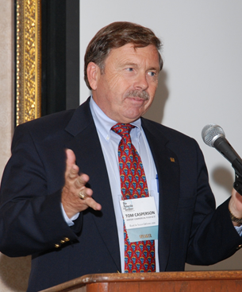

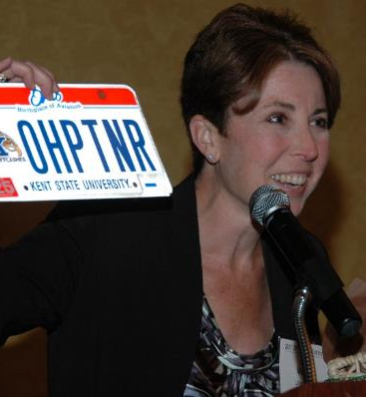
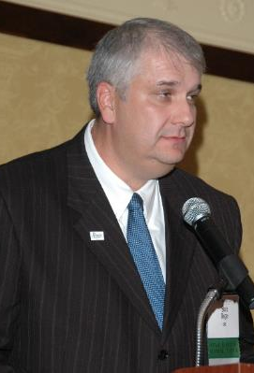


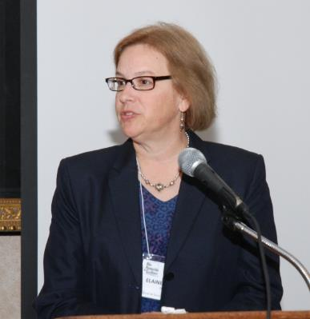
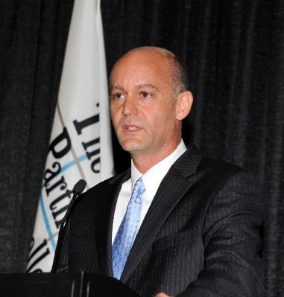
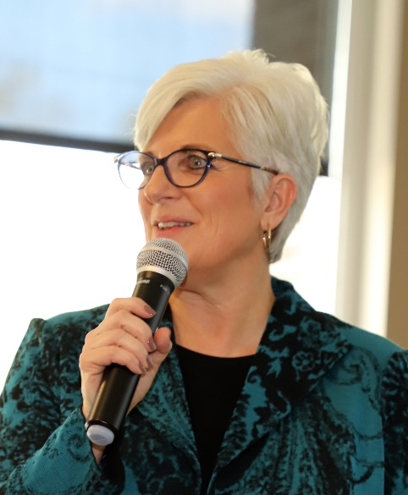

TPE Leadership through the Years
Tom Casperson
1998 – 2001 Executive Director
Michael DiMonte
2001 Executive Director
Casey Mackert
2003 – 2006 Executive Director
Boris Slogar
2007 – 2008 Executive Director
Dr. Elaine Edgar
2008 – 2011 Executive Director
Colonel (retired) Al Faber
2011 – 2014 President/CEO
Dr. Margot Hoffman
2014 – present President/CEO

Slide 10
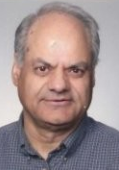

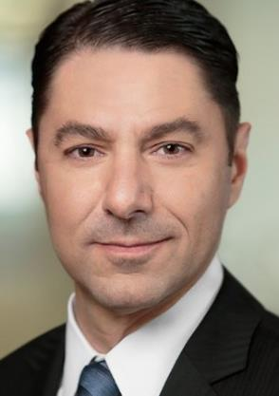
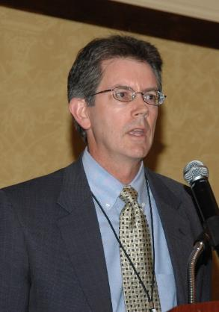
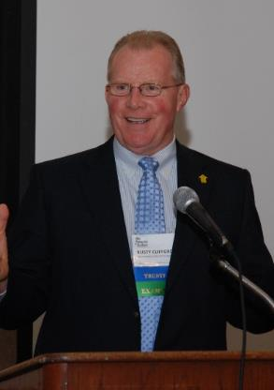
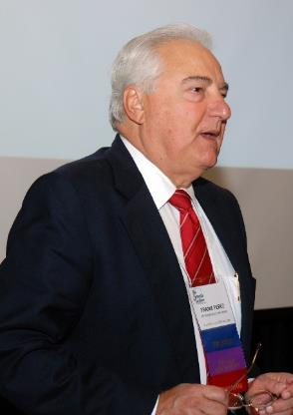
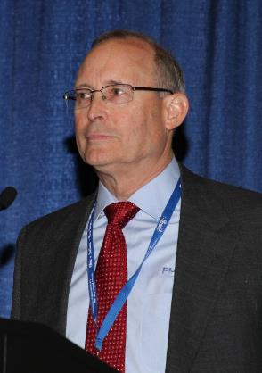
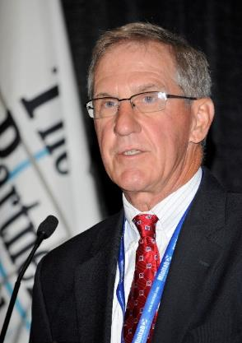
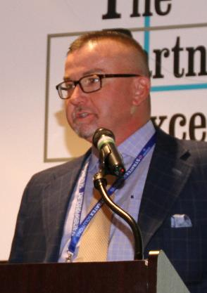
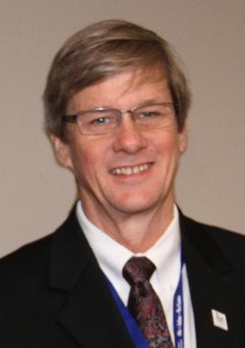
TPE Governance – Chairs, Board of Trustees
Dr. Hira Fotedar
2001 - 2002
Dr. Kendall Stewart
2003 - 2005
Jon Yormick
2005 - 2006
Dr. Mark Montoney
2007 - 2008
Dr. Rusty Clifford
2008 - 2011
Frank Perez
2011 - 2013
Bryan Vaughn
2013 - 2016
Paul Worstell
2016 - 2018
Dr. George McAfee
2019 - 2021
Dr. Kurt Schoch
2022 - present

Slide 11
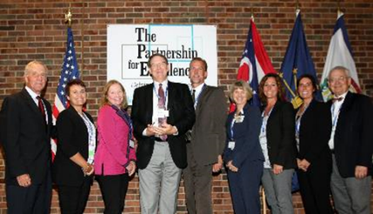
Traditional “Baldrige-based” 50 page Application
  Independent review by trained examiners
  Consensus review by trained examiners
  Site Visit (3 days) by examiner team
  Award selections by Panel of Judges
  Awards ratified by Board of Trustees
TPE Award Cycle
(Full Application)
Awards Presented
Platinum – Governor’s Award
Gold – Achievement of Excellence
Silver – Commitment to Excellence
Bronze – Pledge to Excellence
Category Lead Performer
Blanchard Valley Health System, Findlay, OH - 2019

Slide 12
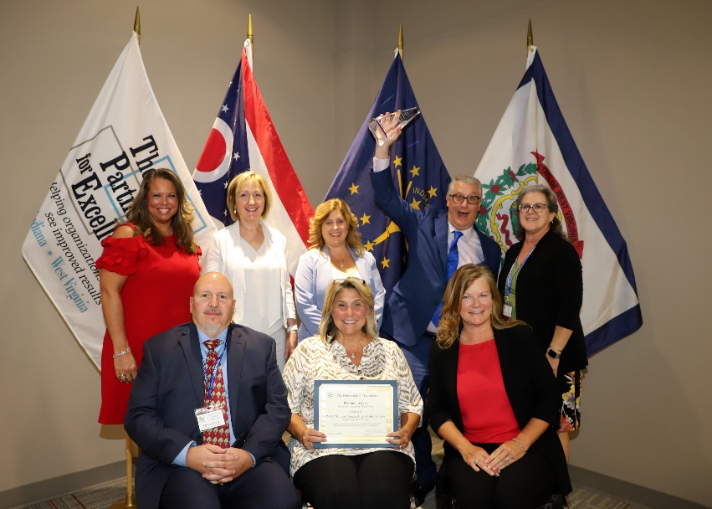
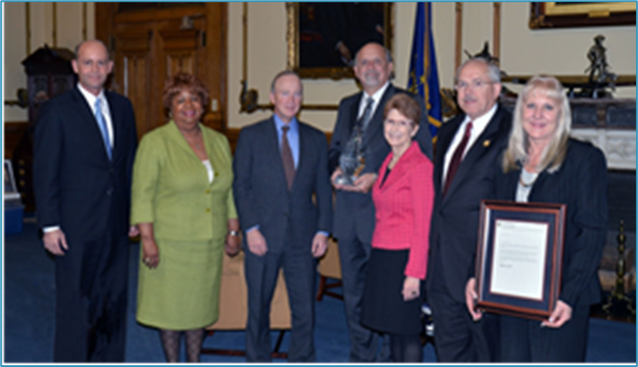
Since 2000;
417 TPE Award Applicants (2000 - 2023)
  Plus 209 Illinois recipients from1995 - 2022
Award Applicants Represent (pre-Illinois):
* 1.7+ million jobs at over 1,800+ work locations
* $ 140+ billion in revenues/budgets
* Estimated 229+ million customers served
24 TPE Award Cycles
626 Recipients
WVU Medicine Camden Clark Medical Center Parkersburg, WV 2022
Citizens Energy, Indianapolis, IN – 2012

Slide 13
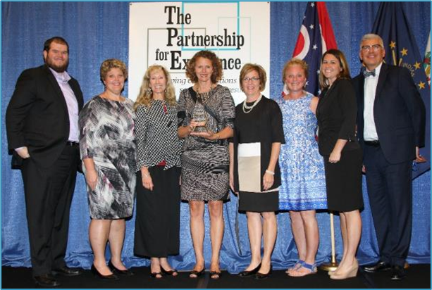
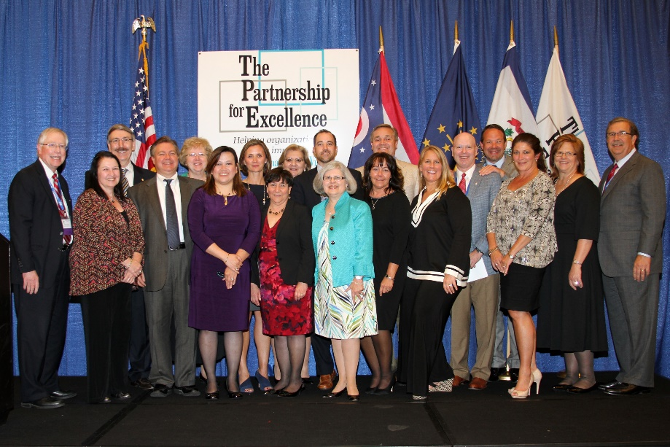
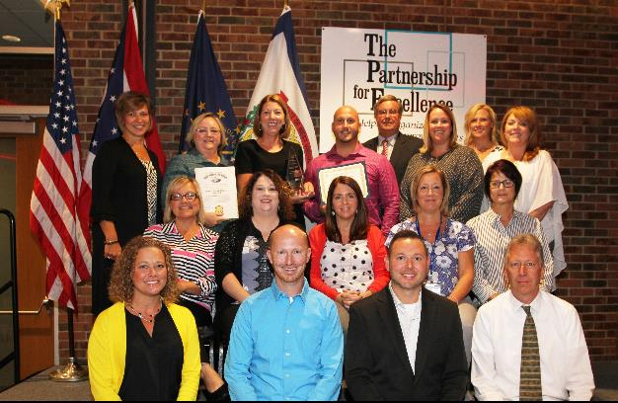
Top Tier Governor’s Award Recipients
Since 2000 TPE/1995 IL
41 Top Tier Award Recipients
  18 in Ohio
  14 in Illinois
  6 in Indiana
  2 in West Virginia
  1 in Maryland (adopted)
Memorial Hospital and Health Care Center Jasper, IN - 2016
Charleston Area Medical Center
Charleston, WV - 2017
ProMedica Memorial Hospital, Fremont, OH - 2018

Slide 14
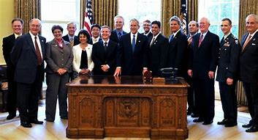
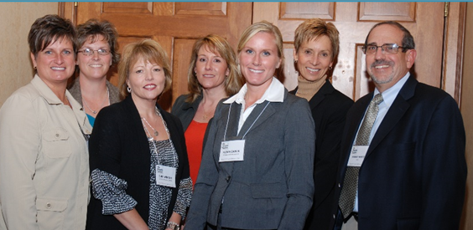

National Baldrige Recipients
(from 4 states)
PRO-TEC Coating Company, Leipsic, OH - 2007
Schneck Medical Center, Seymour, IN - 2011
1988 Global Metallurgical, Inc, Ohio and Motorola, Inc., Illinois
1996 Dana Commercial Credit Corporation, Ohio
2000 Dana Corporation – Spicer Driveshaft Division, Ohio
2002 Motorola Inc., Commercial, Government & Industrial Solutions Sector, Illinois
2003 Community Consolidated School District 15, Illinois
2007 PRO-TEC Coating Company, Ohio
2010 Advocate Good Samaritan Hospital, Illinois
2011 Schneck Medical Center, Indiana
2015 CAMC Health System, West Virginia
2018 Integrated Project Management Company, Inc., Illinois and Memorial Hospital & Health Care Center, Indiana
2019 Illinois Municipal Retirement Fund, Illinois

Slide 15
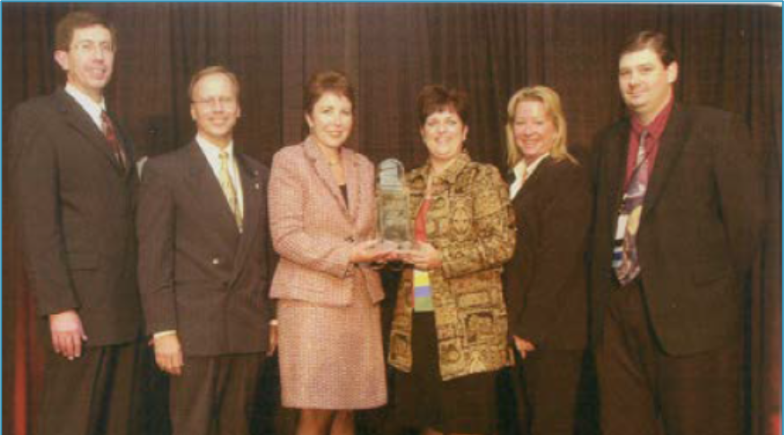
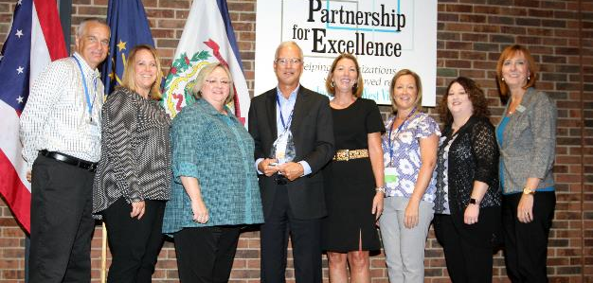
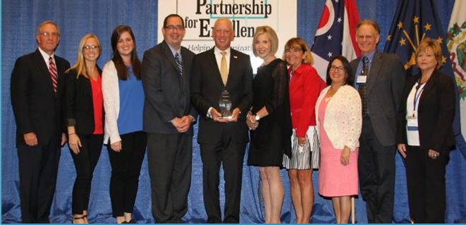
Ohio
4 MBNQA Recipients
Global Metallurgical, Inc.
Dana Commercial Credit Corporation
Dana Corporation – Spicer Driveshaft Division
PRO-TEC Coating Company
18 Governor’s Award Recipients
American Electric Power
Van Dorn Demag Corporation
Eaton Corporation, Van Wert Division
Southern Ohio Medical Center
University of Cincinnati – Admin. & Bus. Services
Dana Corporation, Spicer Outdoor Power Equipment Components
PRO-TEC Coating Company
ODOT (2 awards - Districts 10 & 12)
Riverside Methodist Hospital
Kettering Health Network
Eaton NA Financial Services Center
ProMedica Flower Hospital
Six Disciplines Consulting Services
University Hospitals Geauga Medical Center
ProMedica Memorial Hospital
Blanchard Valley Health System
ProMedica
Dana SOPEC, Fredericktown, OH
ProMedica, Toledo, OH
Six Disciplines Consulting Services, Findlay, OH

Slide 16
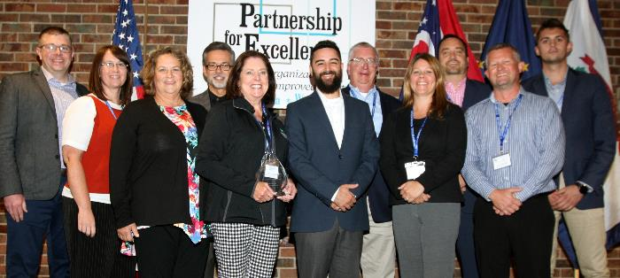
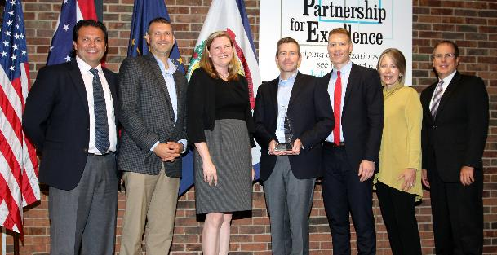
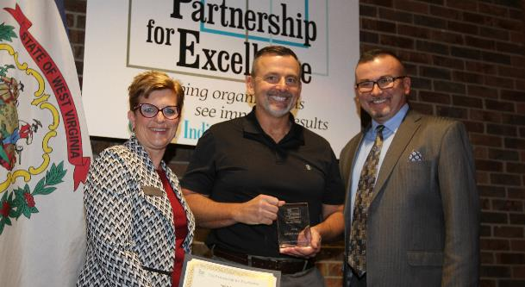
Indiana
Hendricks Regional Health, Danville, IN
Managed Healthcare Services, Lilly USA Indianapolis, IN
2 MBNQA Recipients
Schneck Medical Center
Memorial Hospital and Health Care Center
6 Governor’s Award Recipients
Union Hospital
Citizens Energy (2 times)
Memorial Hospital and Health Care Center
Managed Healthcare Services, Lilly USA
Hendricks Regional Health
Clabber Girl Corporation – Spirit Award
Terra Haute, IN

Slide 17
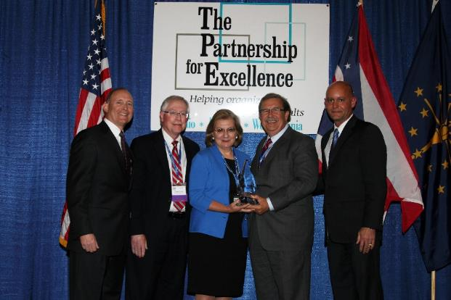
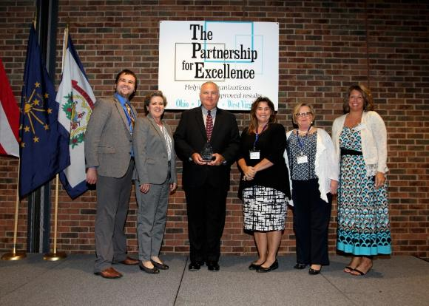
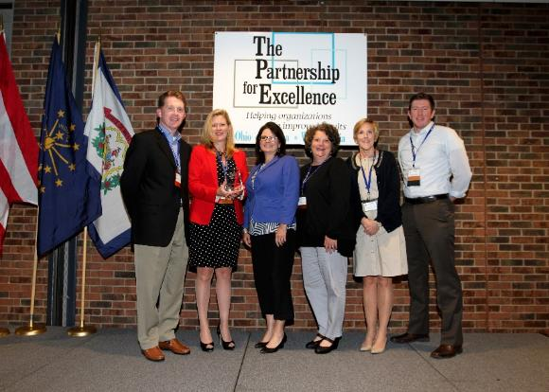
West
Virginia
CAMC Health System, Charleston, WV
WVU Camden Clark, Parkersburg, WV
1 MBNQA Recipient – CAMC Health System
2+ Governor’s Award Recipients
Charleston Area Medical Center
WVU Medicine Camden Clark Medical Center
Meritus Health (Maryland & serves WV)
Pioneer Award
Mon Health
Mon Health, Morgantown, WV

Slide 18
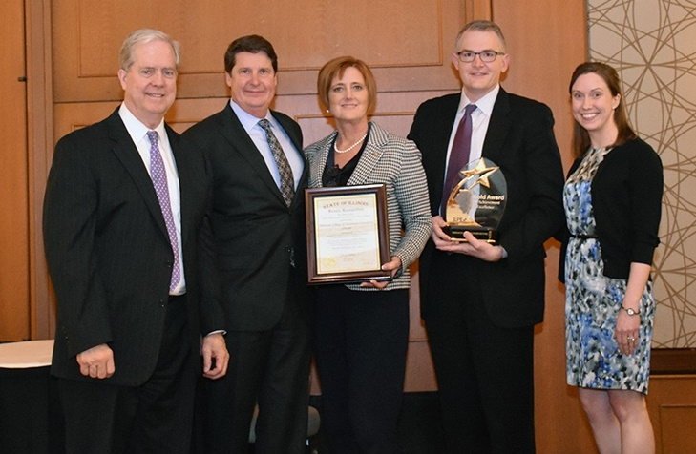
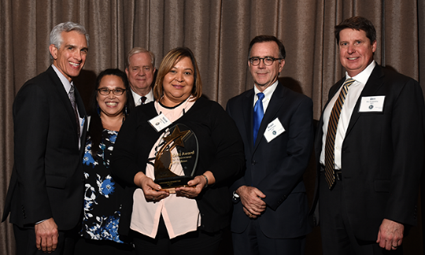
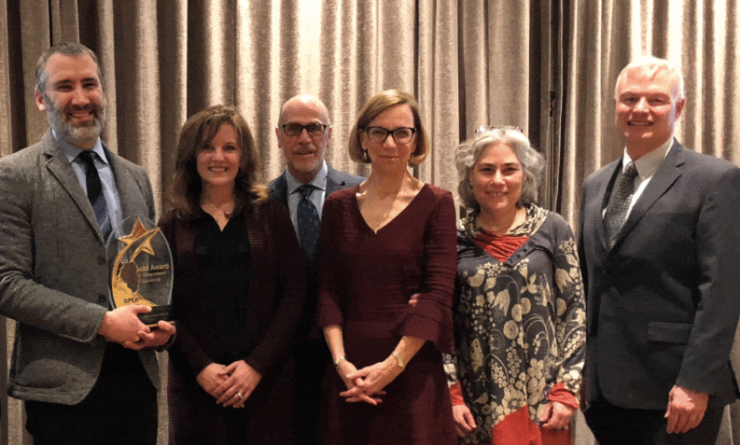
Illinois
6 MBNQA Recipients
Motorola, Inc.
Motorola Inc., Commercial, Government & Industrial Solutions Sector
Community Consolidated School District 15
Advocate Good Samaritan Hospital
Integrated Project Management Company, Inc.
Illinois Municipal Retirement Fund
14 Governor’s Award Recipients
Cash Management Services Division, First National Bank of Chicago
Honeywell's Micro Switch Division
Community Consolidated School District #15, Palatine
Swedish American Health System
St. Mary’s Good Samaritan, Inc., Centralia/Mt. Vernon (2 times)
Methodist Medical Center of Illinois, Peoria
Advocate Good Samaritan Hospital, Downers Grove
Sarah Bush Lincoln Health System, Mattoon
United Cerebral Palsy Land of Lincoln, Springfield
Advocate Lutheran General Hospital, Park Ridge
American College of Healthcare Executives, Chicago
Illinois Municipal Retirement Fund, Oak Brook
Integrated Project Management, Inc, Burr Ridge
American College of Healthcare Executives, Chicago
Illinois Municipal Retirement Fund, Oak Brook
Integrated Project Management, Burr Ridge

Slide 19
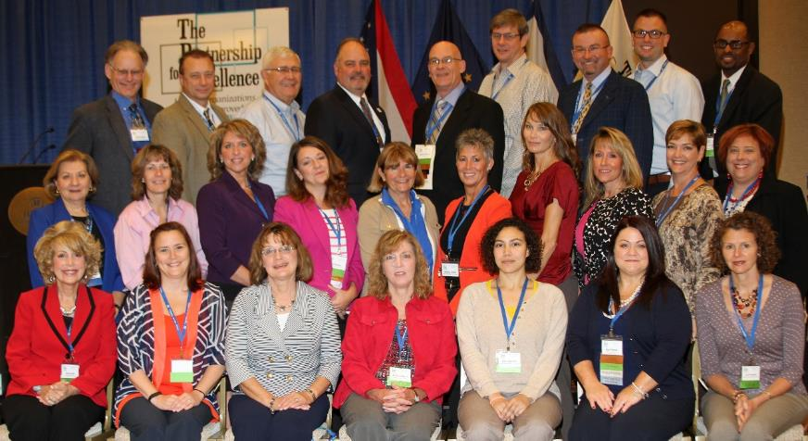
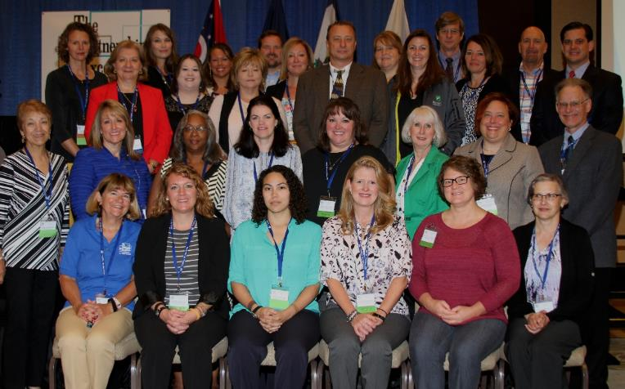
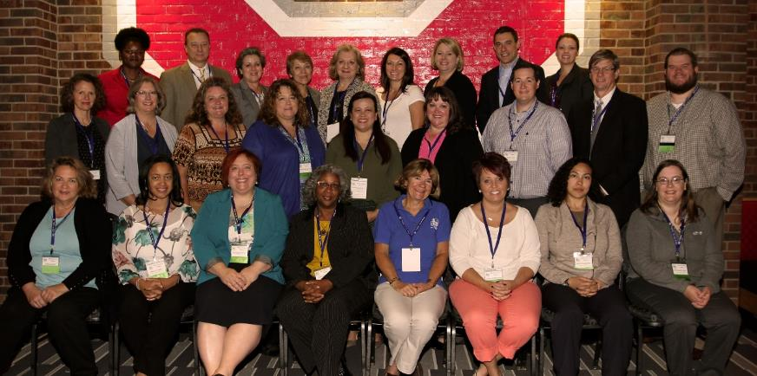
TPE Examiners are Amazing!
2,703 Examiners = $39.5 million in volunteer services
Plus 1,100 IL Examiners = $16 million
3,803 Total Examiners, $55.5 million

Slide 20
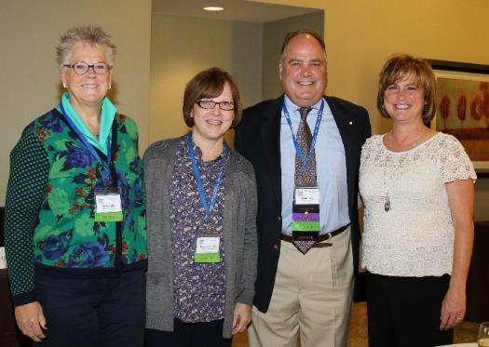
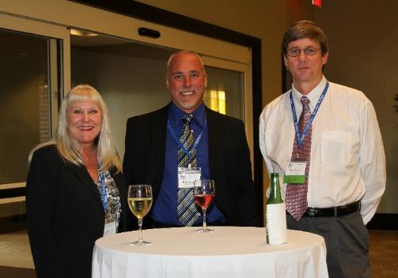
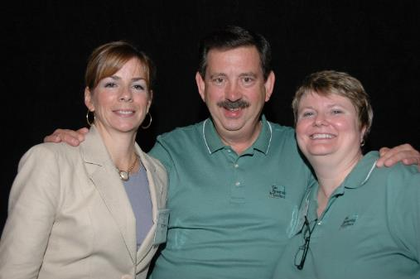

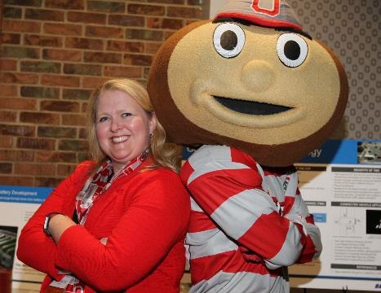
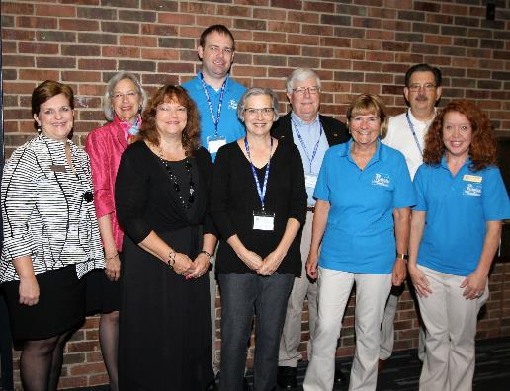
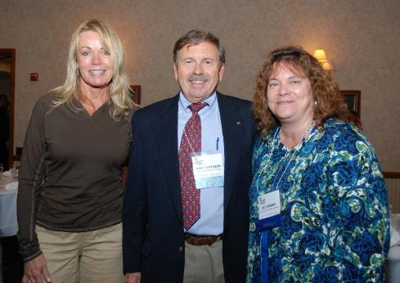
23 Quest for Success Conferences

Slide 21
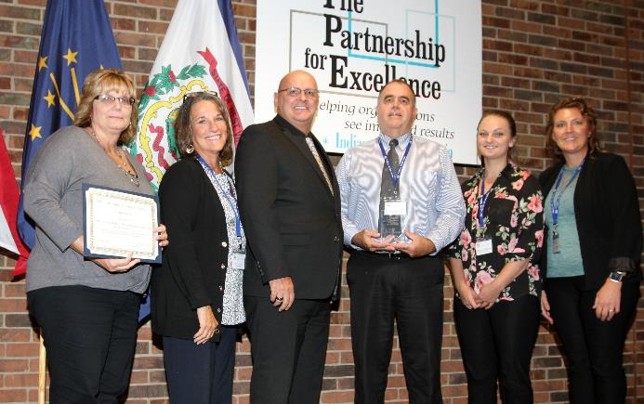
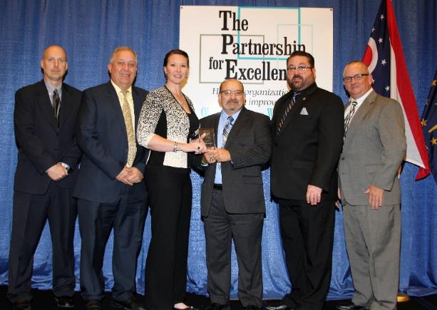
Advising & Partnering
First Awards in 2009
Spirit Award – 5 Page Organizational Profile
Pioneer Award – 25 Page Application to Baldrige Excellence Builder
Perry County Board of DD, New Lexington, OH
Braun Ambulance, Van Wert, OH

Slide 22
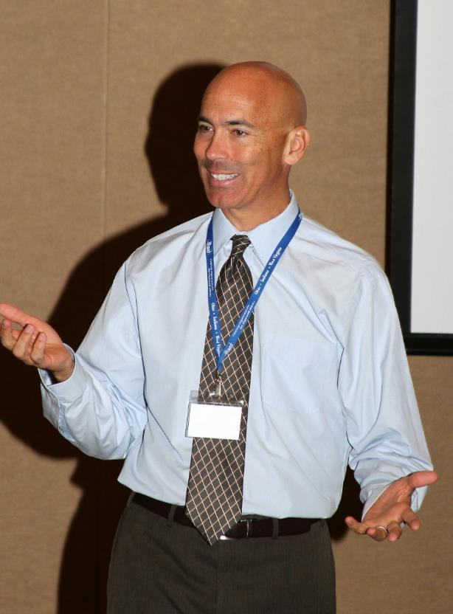

LeanOhio Boot Camps
2014 - 2016

Slide 23




Leader2Leader Collaborative
2018 – Present
A year-long leadership development program grounded in Baldrige Criteria

Slide 24




Frank J. Perez Leadership Award
Recipients
2014 – Paul Worstell
2015 – Tammy Dye & Suki Wright
2016 – Dr. Rusty Clifford
2017 – Steve Wall
2018 – Dr. Glenn Crotty
2019 – Brenda Grant
2020 – Dr. Kevin Webb
2021 – Shane Sommers
2022 – Maricris Miller

Slide 25




President’s Award for Extraordinary Service & Volunteerism
2014 – Brenda Grant
2015 – Mike Belter & Kurt Schoch
2016 – Maricris Miller
2017 – Michael Drake
2018 – Lori Persohn
2019 – Adriana Pust
2020 – Jeff Meyer
2021 – Dr. William Kose
2022 – Kent Holloway

Slide 26



TPE Advocate Scholarship Recipients
Scholarship to attend Quest for Success Conference
2018 – Leigh Esper
2019 – Dr. Chris Ward
2020 – Adam Werne
2021 – Tricia Valasek

Slide 27


25 Years of Amazing Volunteers
Board of Trustees
Examiners
Team Leaders
Advising & Partnering
Trainers
Mentors
Speakers/Presenters
Panel of Judges
TPE Committees
Conference Committees

Slide 28



Mission: To cultivate organizational performance excellence and continuous improvement in Ohio, Indiana, West Virginia and Illinois
Vision: To be the partner of choice for creating high-performing organizations that produce exceptional results
Values:
    Excellence
    Diversity, Equity & Inclusion
    Integrity
    Visionary Leadership
    Professionalism
    Agility
TPE’s Mission, Vision & Values
The only state based
program to conduct &
submit its own Self-
Assessment twice!

Slide 29


To learn more about The Partnership for Excellence, go to
thepartnershipforexcellence.org

